Slide 1
Introduction to CSS

Slide 2
CSS = Cascading Style Sheets
CSS is a "style sheet language" that lets you style the elements on your page.
CSS is works in conjunction with HTML, but is not HTML itself.
So far we learned how to create a paragraph like this in HTML, but how do we add color to it or align it to the center of the page?

Slide 3
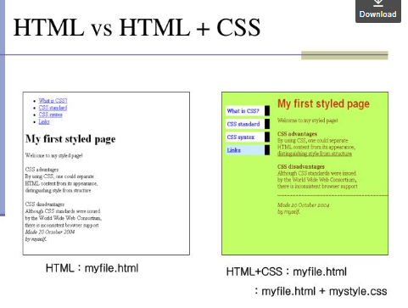

Slide 4
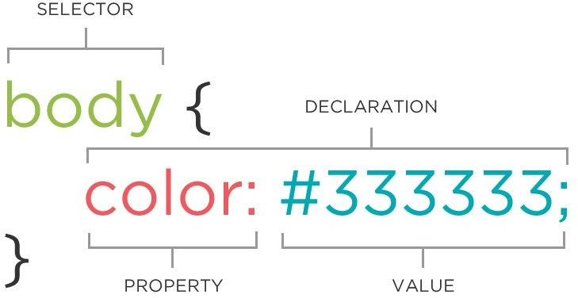
The CSS Rule
A block of CSS code is a rule.
The rule starts with a selector.
It has sets of properties and values.
A property-value pair is a declaration.

Slide 5
CSS Syntax
Selector: HTML element(s) that you want to apply the CSS rule to
Declaration: property-value pairs that define the style you plan to use on HTML element
selector { property: value; property: value; property: value;
}
Declarations end with a semicolon
Declaration groups are surrounded by curly brackets.
p {
color: red;
}

Slide 6
Connecting CSS to HTML
Now we know what does a CSS rule look like. But how do we use it to customize our HTML pages?
Inline
Embedded
External

Slide 7
In-line Styles
Inline styles are directly applied to the particular HTML element.
It’s good for quick changes of a specific HTML element in current web pages.
However, it’s the least CSS styles coverage than external and internal style sheets because the CSS styles will only apply to a specific HTML element.

Slide 8
Connecting CSS to HTML: Inline
Uses the HTML attribute style.
<p style="color:red">Some text.</p>
How would you change the color of all the paragraphs in your HTML file to red?

Slide 9
Connecting CSS to HTML: Inline
Uses the HTML attribute style.
<p style="color:red">Some text.</p>
How would you change the color of all the paragraphs in your HTML file to red?
Add style attribute to all paragraph elements! Not very efficient.

Slide 10


Style Location: Inline

Slide 11
internal style
Inside <head> element, use <style> tag.
<head>
<style type="text/css"> p {
color: blue; font-size: 12px;
}
</style>
</head>
You can change the style of all paragraphs in one HTML file at once.

Slide 12
External Style
Put CSS rules in a separate file and use a link to that file in all your HTML files.
<!doctype html>
<html>
<head>
<link rel="stylesheet" type="text/css" href="style.css">
</head>
<body>
....
</body>
</html>
myfile.html

Slide 13
CSS Selectors

Slide 14
CSS Selectors: Element
The element selector selects all elements with the specified element name.
p {
color: yellow;
}
body {
background-color: red;
}

Slide 15
CSS Selectors: Id
The #id selector styles the element with the specified id attribute.
<h1 id="header">This is my page header</h1>
<strong id="firstname">This is my first name</strong> #header {
color: yellow;
}
#firstname {
background-color: red;
}

Slide 16
CSS Selectors: Class
The .class selector selects all elements with a specific class attribute.
<h1 class="maintitle">Main title goes here.</h1>
<p class="address">1212 some Rd. Tallahassee, FL</p>
.maintitle {
font-size: 100px;
}
.address {
font-style: italic;
}

Slide 17
CSS Selectors: Class
You can also specify that only specific HTML elements should be affected by a class. To do this, start with the element name, then write the period (.) character, followed by the name of the class.
<h1 class="maintitle">Main title goes here.</h1>
<p class="maintitle">1212 some Rd. Tallahassee, FL</p> h1.maintitle {
font-size: 100px;
}

Slide 18
CSS Selectors: *
The * selector selects all elements.
* {
font-size: 10px;
}
The * selector can also select all elements inside another element
p * {
background-color: green;
}

Slide 19
CSS Selectors: Element Element
The element element selector is used to select elements inside elements.
<p>This is my <strong>address</strong> in green background.</p> p strong {
background-color: green;
}

Slide 20
CSS Selectors: Element,Element
To style several elements with the same style, separate each element name with a
comma.
<p>This is a paragraph.</p>
<h1>This is a heading.</h1> p,h1 {
background-color: green;
}
p {
font-size: 10px;
}

Slide 21
CSS Selectors
There are a number of other CSS selectors that can be used. For a complete list you can check out this webpage:
https://www.w3schools.com/cssref/css_selectors.asp

Slide 22
CSS Values

Slide 23
CSS Values: Lengths and Percentages
There are many property-specific units for values used in CSS, but there are some general units that are used by a number of properties and it is worth familiarizing yourself with these before continuing.
px (such as font-size: 12px) is the unit for pixels.
pt (such as font-size: 12pt) is the unit for points, for measurements typically in printed media.
% (such as width: 80%) is the unit for… wait for it… percentages.
When a value is zero, you do not need to state a unit. For example, if you wanted to specify no border, it would be border: 0.

Slide 24
CSS Values: Color
Your browser can accept colors in many different ways:
Hexadecimal value
RGB value
HSL value

Slide 25

RGB Value
In HTML, a color can be specified as an RGB value, using this formula:
rgb(red, green, blue)
Each parameter (red, green, and blue) defines the intensity of the color with a value between 0 and 255.
This means that there are 256 x 256 x 256 = 16777216 possible colors!

Slide 26
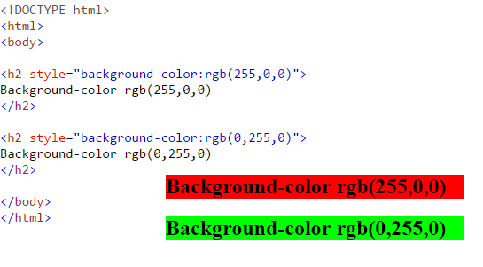
RGB Value
rgb(255, 0, 0) is displayed as red, because red is set to its highest value (255), and the other two (green and blue) are set to 0.
Another example, rgb(0, 255, 0) is displayed as green, because green is set to its highest value (255), and the other two (red and blue) are set to 0.
To display black, set all color parameters to 0, like this: rgb(0, 0, 0).
To display white, set all color parameters to 255, like this: rgb(255, 255, 255).

Slide 27
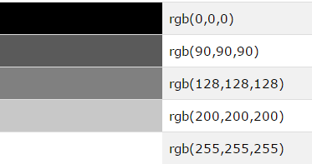
RGB Value Cont’d
Shades of gray are often defined using equal values for all the 3 light sources:

Slide 28
RGBA VALUES
RGBA color values are an extension of RGB color values with an Alpha channel which specifies the opacity for a color.
An RGBA color value is specified with: rgba(red, green, blue, alpha)
The alpha parameter is a number between 0.0 (fully transparent) and 1.0 (not transparent at all):

Slide 29
HTML HEX COLOURS
In HTML, a color can be specified using a hexadecimal value in the form:
#rrggbb
Where rr (red), gg (green) and bb (blue) are hexadecimal values between 00 and ff (same as decimal 0-255).
For example, #ff0000 is displayed as red, because red is set to its highest value (ff), and the other two (green and blue) are set to 00.
Shades of gray are often defined using equal values for all three parameters e.g #404040

Slide 30
HSL COLOR VALUES
In HTML, a color can be specified using hue, saturation, and lightness (HSL) in the form:
hsl(hue, saturation, lightness)
Hue is a degree on the color wheel from 0 to 360. 0 is red, 120 is green, and 240 is blue.
Saturation is a percentage value, 0% means a shade of gray, and 100% is the full color.
Lightness is also a percentage value, 0% is black, and 100% is white.

Slide 31
Experiment hsl and hsla

Slide 32
CSS Properties

Slide 33
CSS Properties: Color
To define the text color we use the color property:
p {
color: yellow;
}
To define the background color we use the background-color property:
body {
background-color: red;
}

Slide 34
CSS Properties: Text
You can alter the size and shape of the text on a web page with a range of properties.
font-family: This is the font itself, such as Times New Roman, Arial, or Verdana.
There are a select few “safe” fonts (the most commonly used are Arial, Verdana and Times New Roman), but you can specify more than one font, separated by commas. The purpose of this is that if the user does not have the first font you specify, the browser will go through the list until it finds one it does have.

Slide 35
CSS Properties: Text
p {
font-family: Arial, Helvetica, Serif;
}
will look for the Arial font first and, if the browser can’t find it, it will search for Helvetica, and then a common serif font.
if the name of a font is more than one word, it should be put in quotation marks
p {
font-family: "Times New Roman";
}

Slide 36
CSS Properties: Text
font-size: sets the size of the font (remember units such as px, em, pt)
font-weight: states whether the text is bold or not (bold, light,normal,...) font-style: states whether the text is italic or not (italic, normal)
text-decoration: states whether the text has got a line running under, over, or through it. (underline, overline, line-through, none)
text-transform: will change the case of the text (capitalize, uppercase, lowercase, none)

Slide 37
CSS Properties: Text
body {
font-family: arial, helvetica, sans-serif; font-size: 14px;
}
a {
h1 {
font-size: 2em;
}
text-decoration: none;
}
strong {
font-style: italic;
text-transform: uppercase;
}
h2 {
font-size: 1.5em;
}

Slide 38
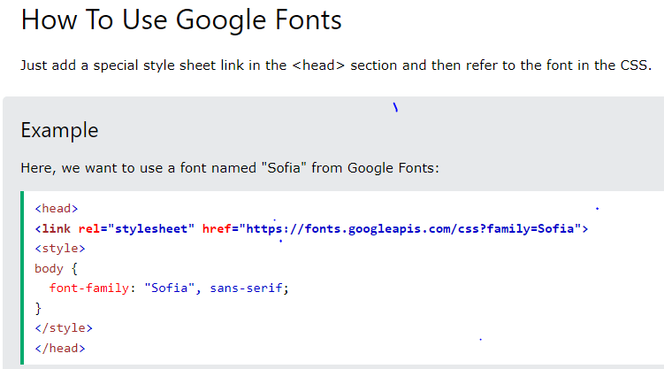
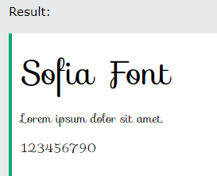
Google fonts
If you do not want to use any of the standard fonts in HTML, you can use Google Fonts.They are free to use, and have more than 1000 fonts

Slide 39
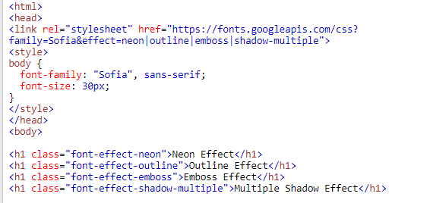

Fonts effects

Slide 40
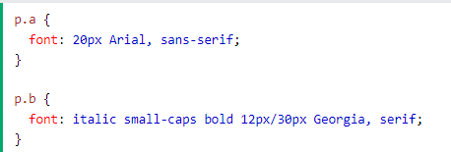
Font short hand property
Use font to set several font properties in one declaration

Slide 41
CSS Properties: Text Spacing
letter-spacing: sets spacing between letters. The value can be a length or normal.
word-spacing: sets spacing between words. The value can be a length or normal.
line-height: sets the height of the lines in an element, such as a paragraph, without adjusting the size of the font. It can be a number (which specifies a multiple of the font size, so “2” will be two times the font size, for example), a length, a percentage, or normal.
text-indent: will indent the first line of a paragraph, to a given length or percentage. text-align: will align the text inside an element to left, right, center, or justify

Slide 42
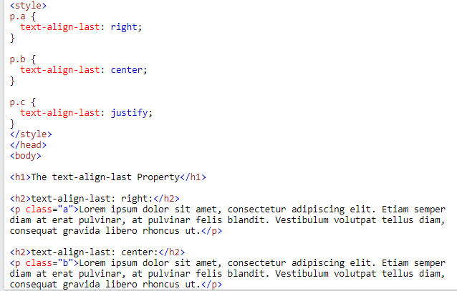
Text alignment

Slide 43
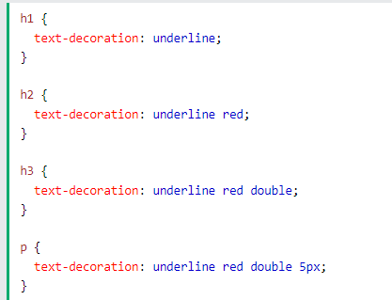
Text decoration

Slide 44
Styling Links
color :
Changes the color of the links
background-color :
Highlights the link, as if it had been highlighted with a highlighter pen
text-decoration :
Underline, strike through, over-line, blink

Slide 45
Styling links…
Pseudo-classes of links:
Link:
Styles for links in general
Visited:
Styles the links which are already visited
Hover:
Styles when some on hovering over a link
Active:
Styles the links when a links is being clicked

Slide 46
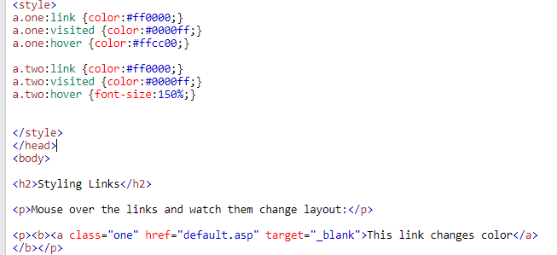
This example demonstrates how to add other styles to hyperlinks:

Slide 47
4. Styling Background
background-color:
Specifies the background color
background-image:
Specifies the background image
background-repeat:
Specifies whether the image should repeat or not
background-position:
Where an image should be positioned

Slide 48
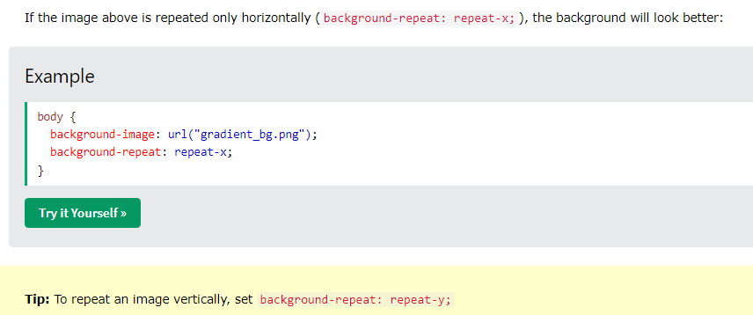
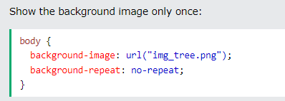
Background image and repeat

Slide 49

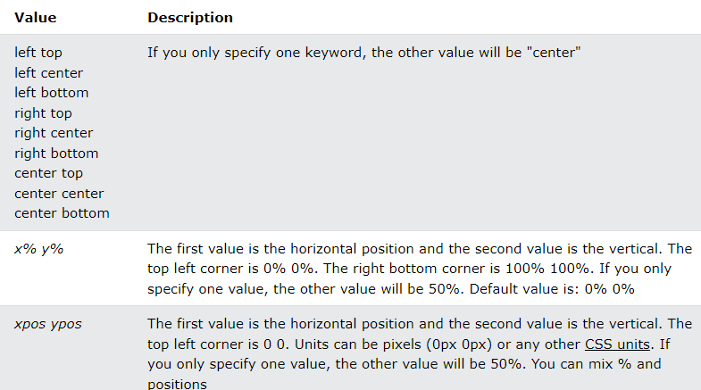
Background position

Slide 50
https://www.w3schools.com/cssref/playdemo.php?filename=playcss_background-position

Slide 51
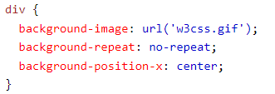
Background position-x property & Background position-y property
Background position-y property in same way

Slide 52
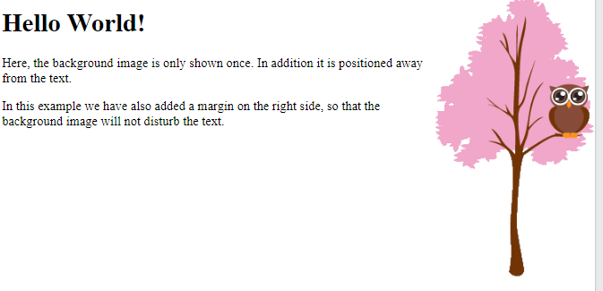

Slide 53
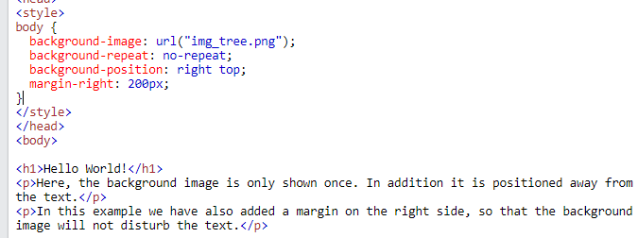

Slide 54
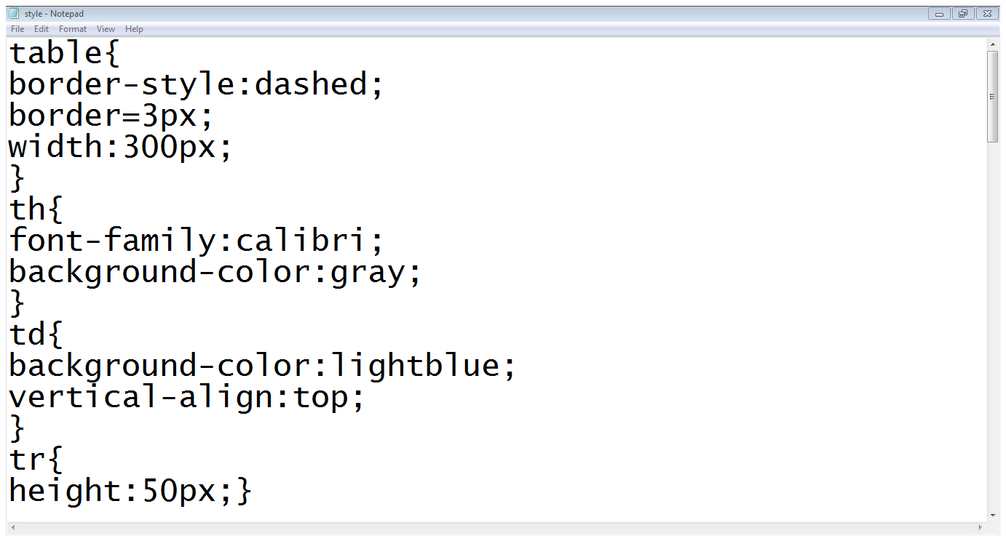
Styling tables…
Table settings
Th settings
Td settings
Tr settings

Slide 55
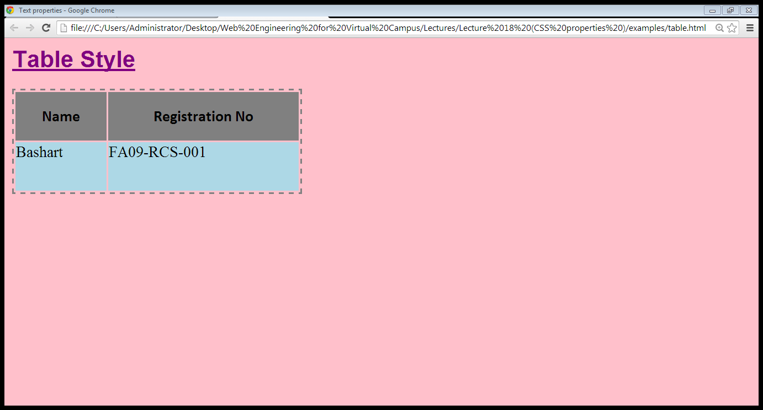
Styling tables…

Slide 56
